Slide 1
Portfolio
Zhenyu Wang
https://kkr9551.github.io/bannedbook/

Slide 2
My role in the team: research lead
My responsibilities:
Conduct 15 interviews to gather qualitative data;
Use personas and user journey maps to analyse data, and elicit HMW questions for ideation;
Improve the website with HTML and CSS;
Conduct Facial Expression Analysis and self-reported metrics (Attrakdiff);

Slide 3
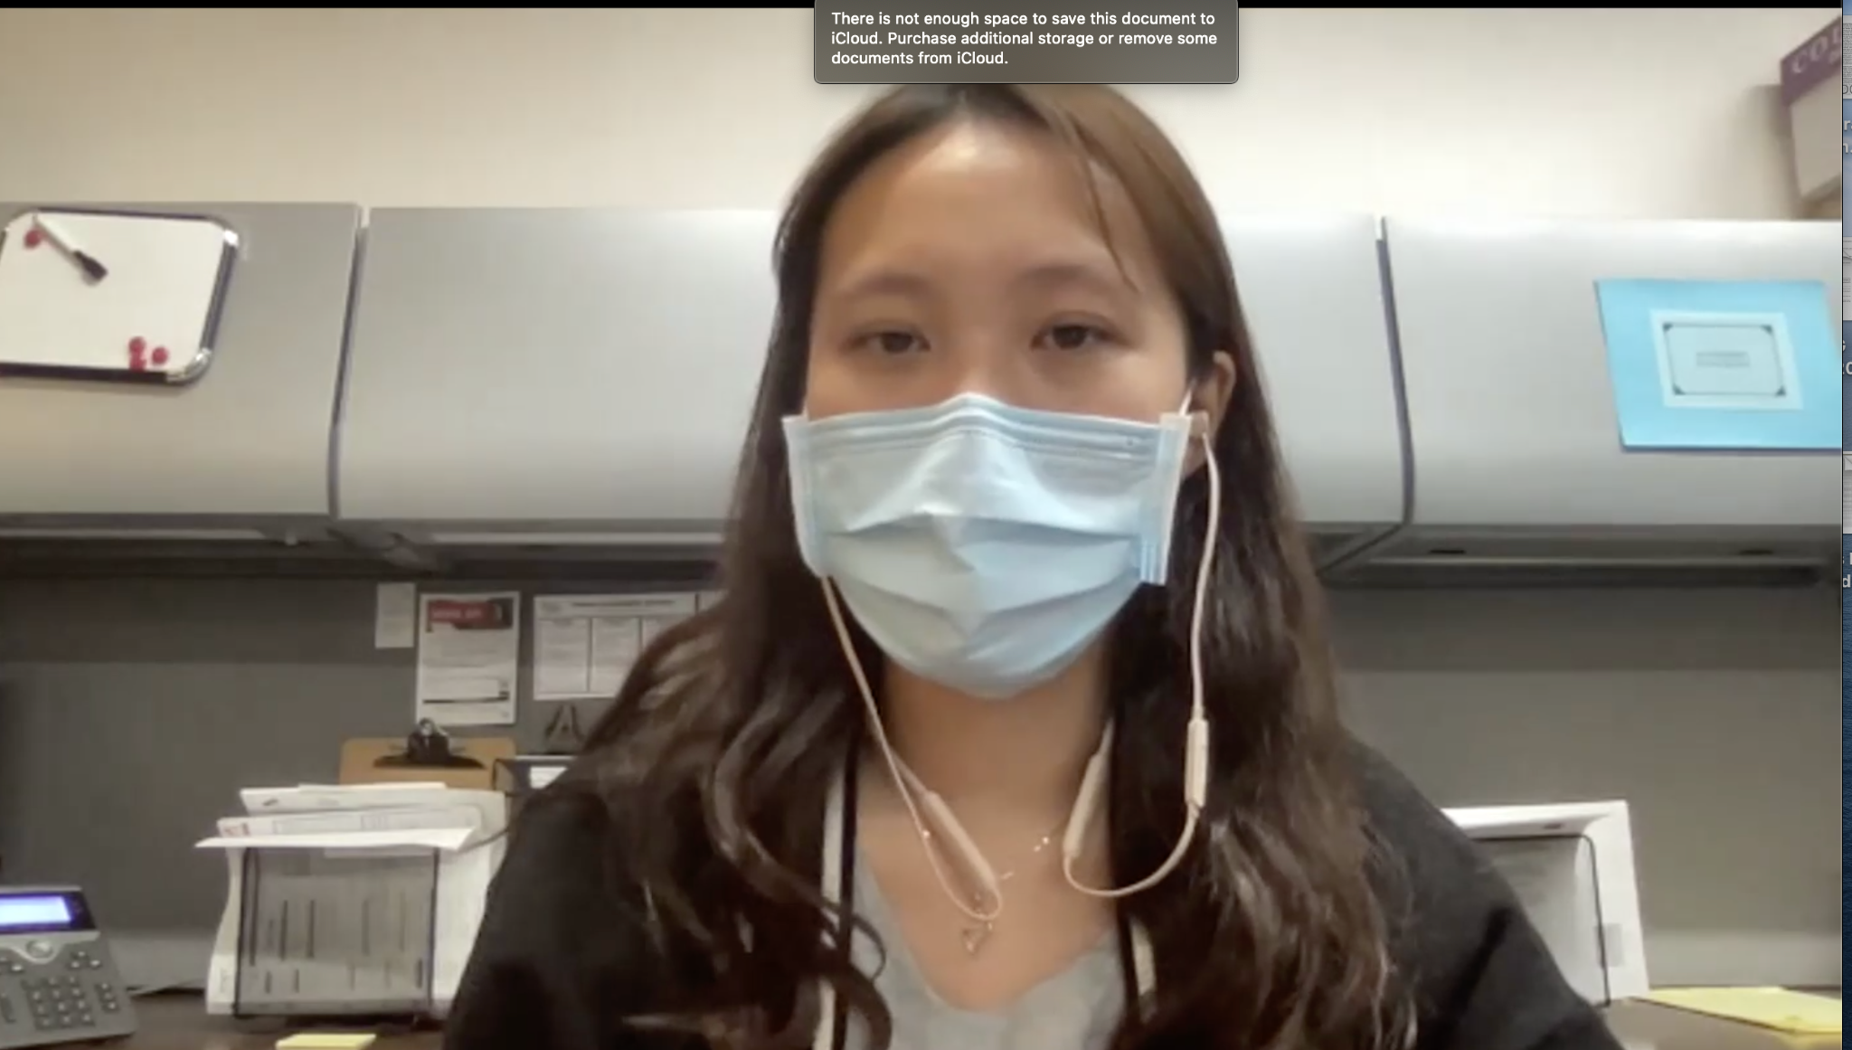
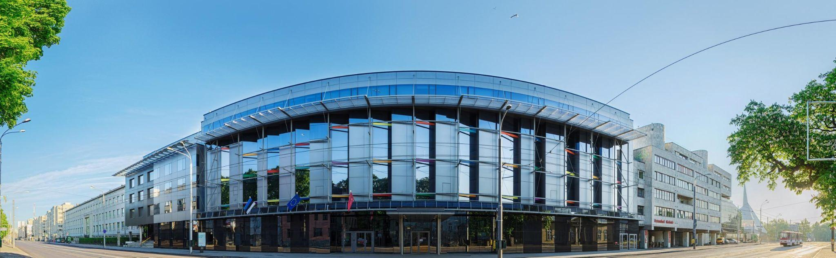
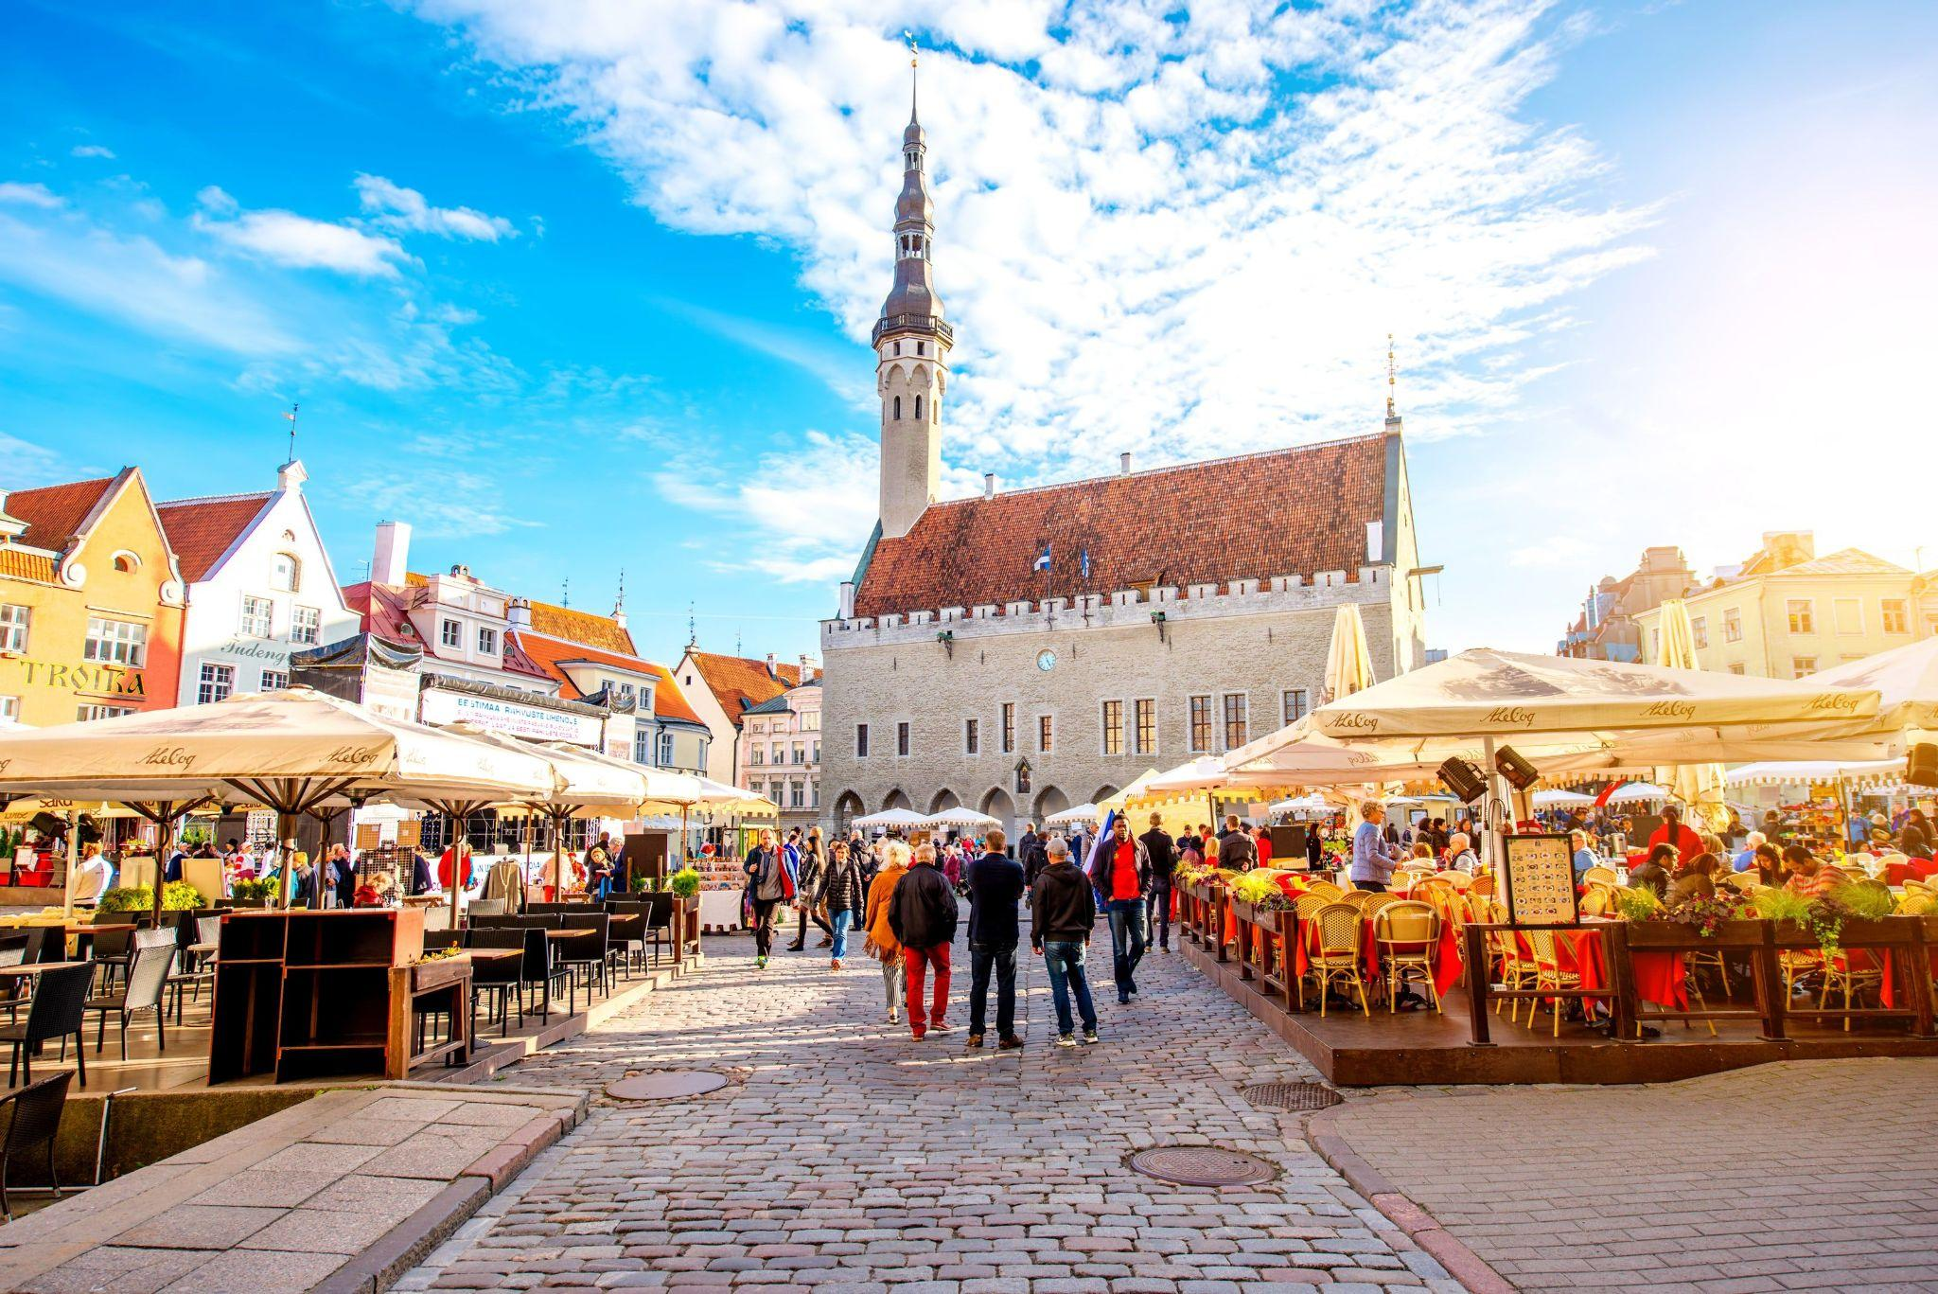
Data Collection & Data Analysis
Zoom meeting (the screenshot is consented by Sherry Yang)
Interviews and observations:
4
Online Interviews
10
Physical Individual Interviews
Campus
1
Group Interview
The Old Town

Slide 4
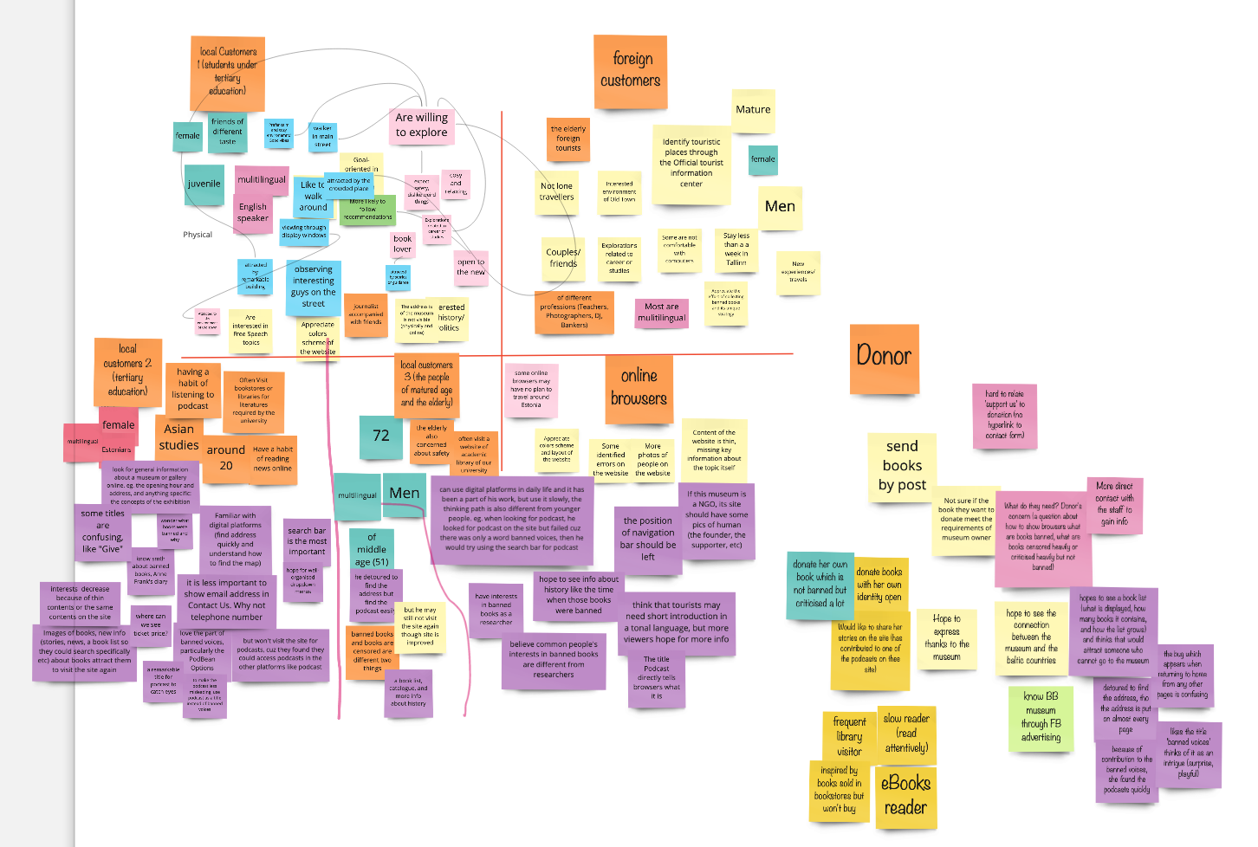

Slide 5
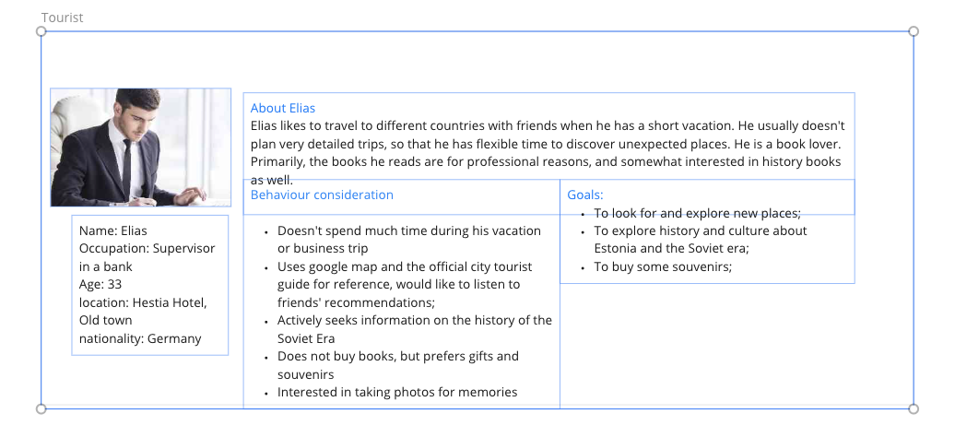
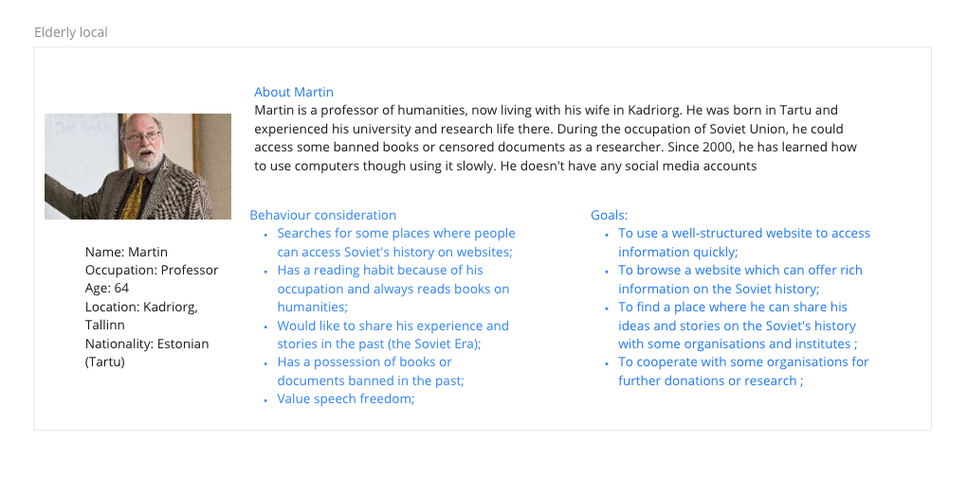
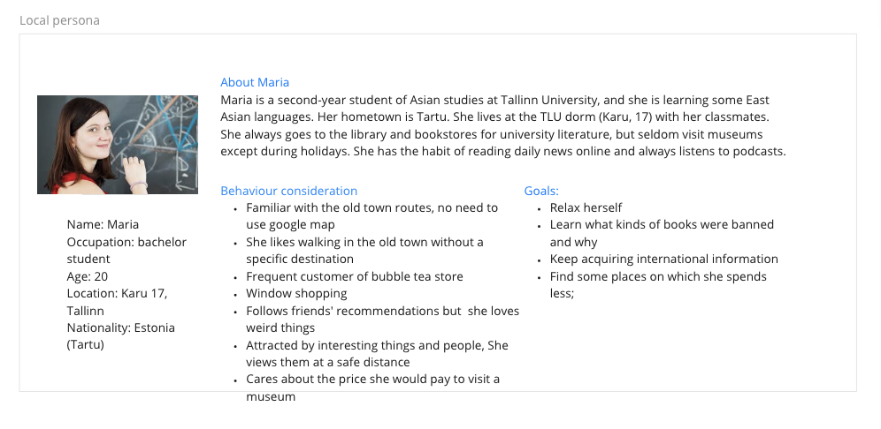
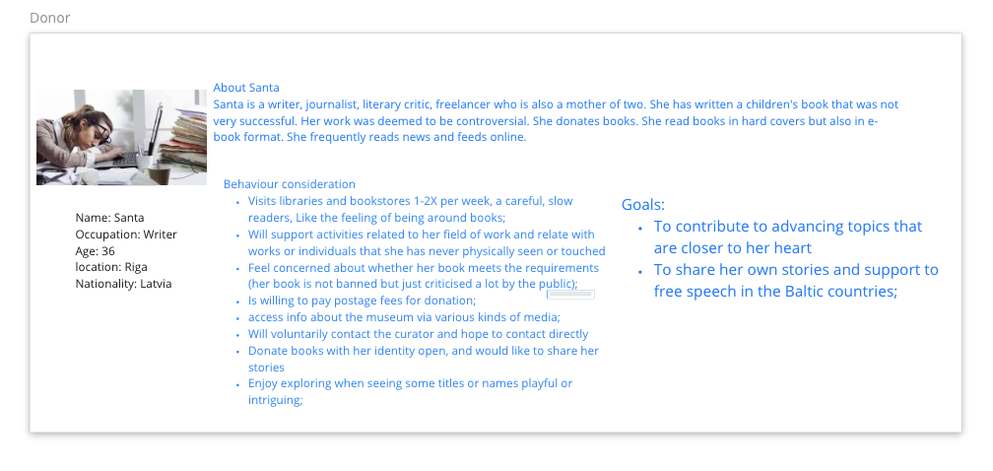
Personas
Tourist
Young local
Elderly local
Donor

Slide 6
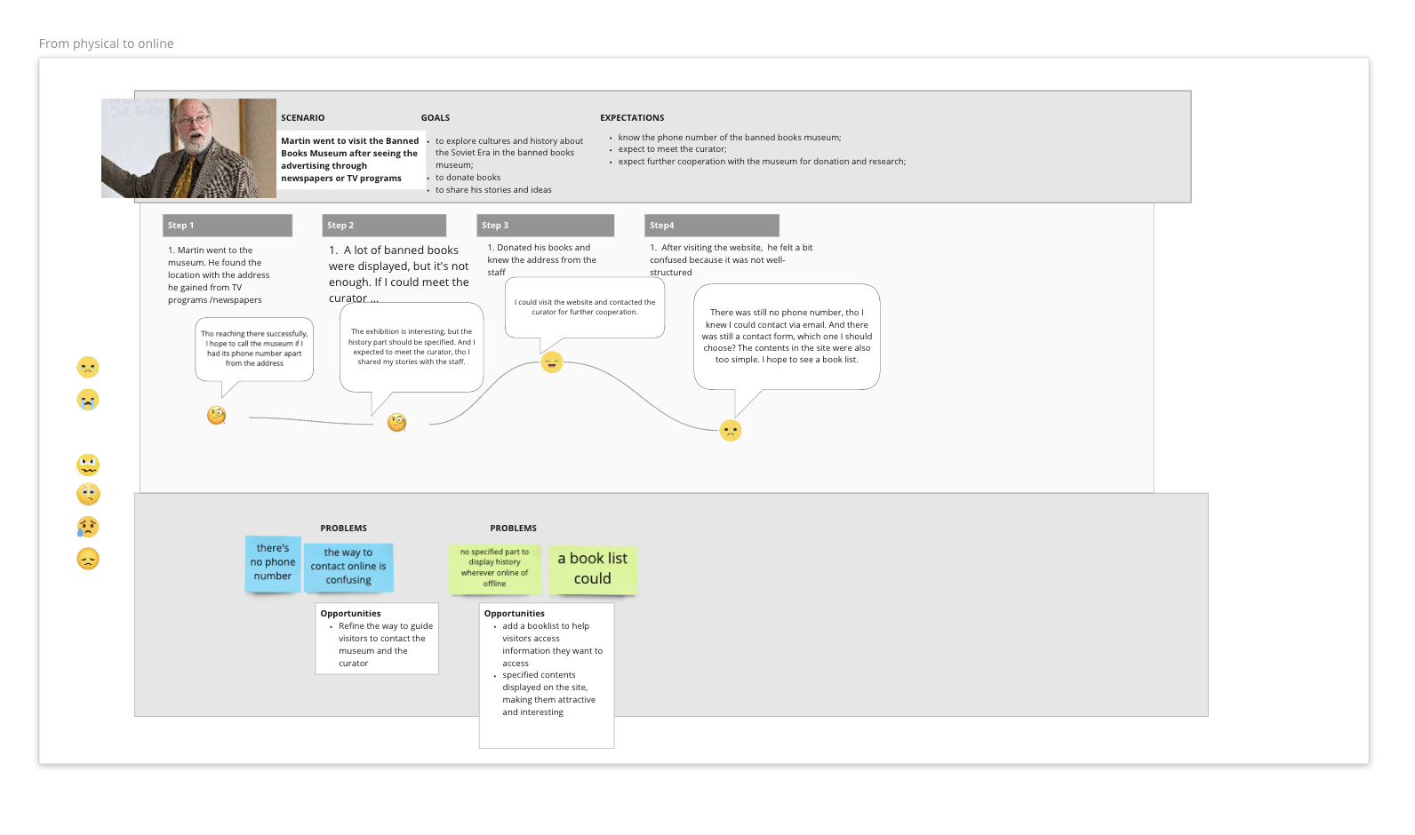
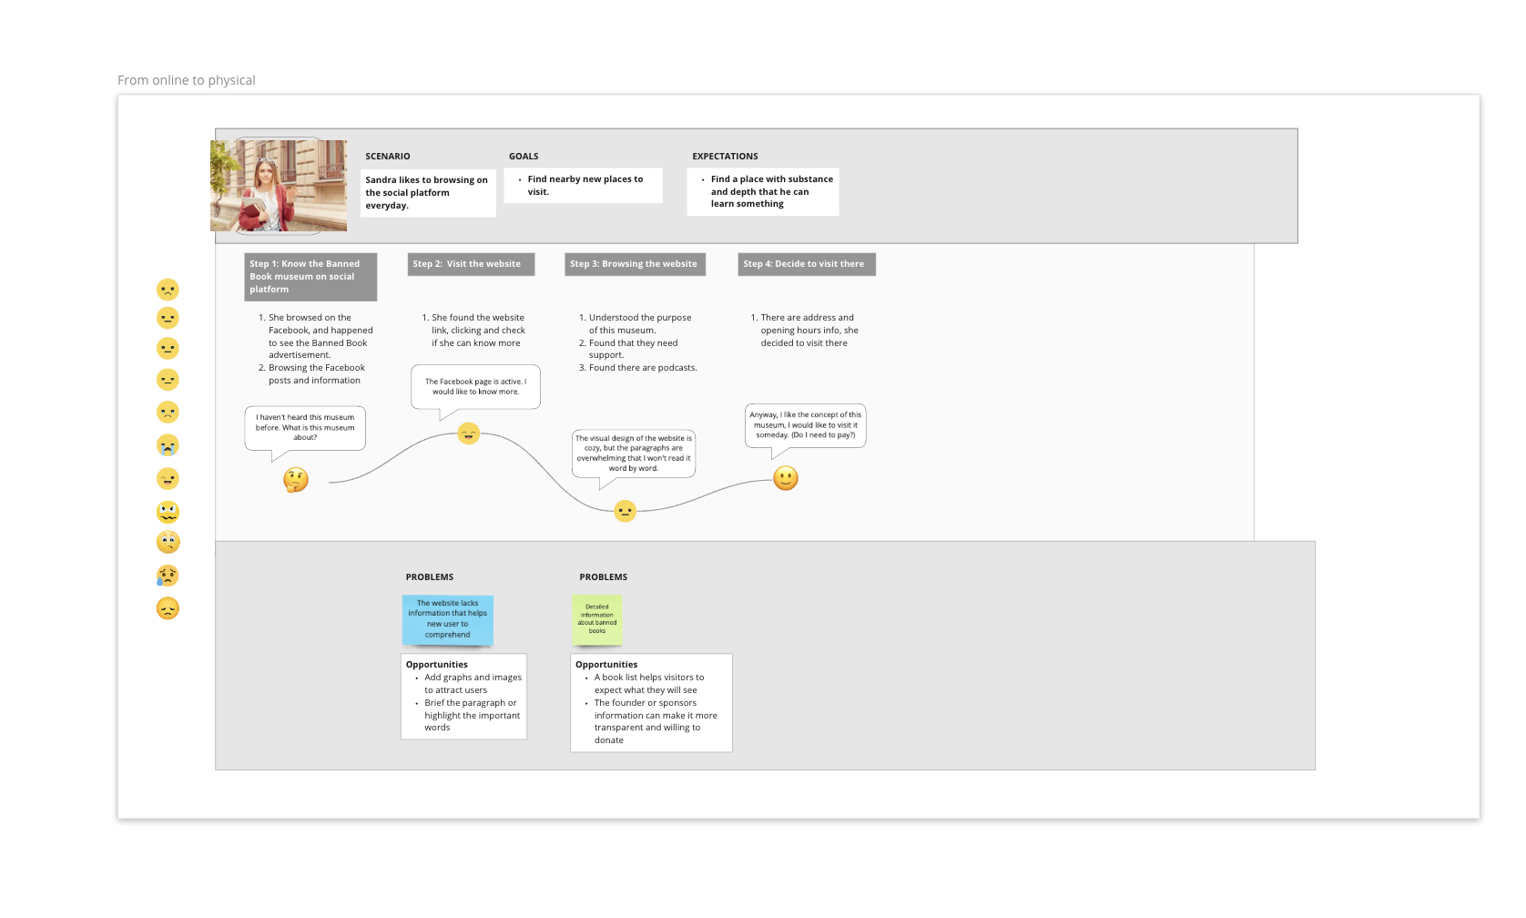
User Journey Maps

Slide 7
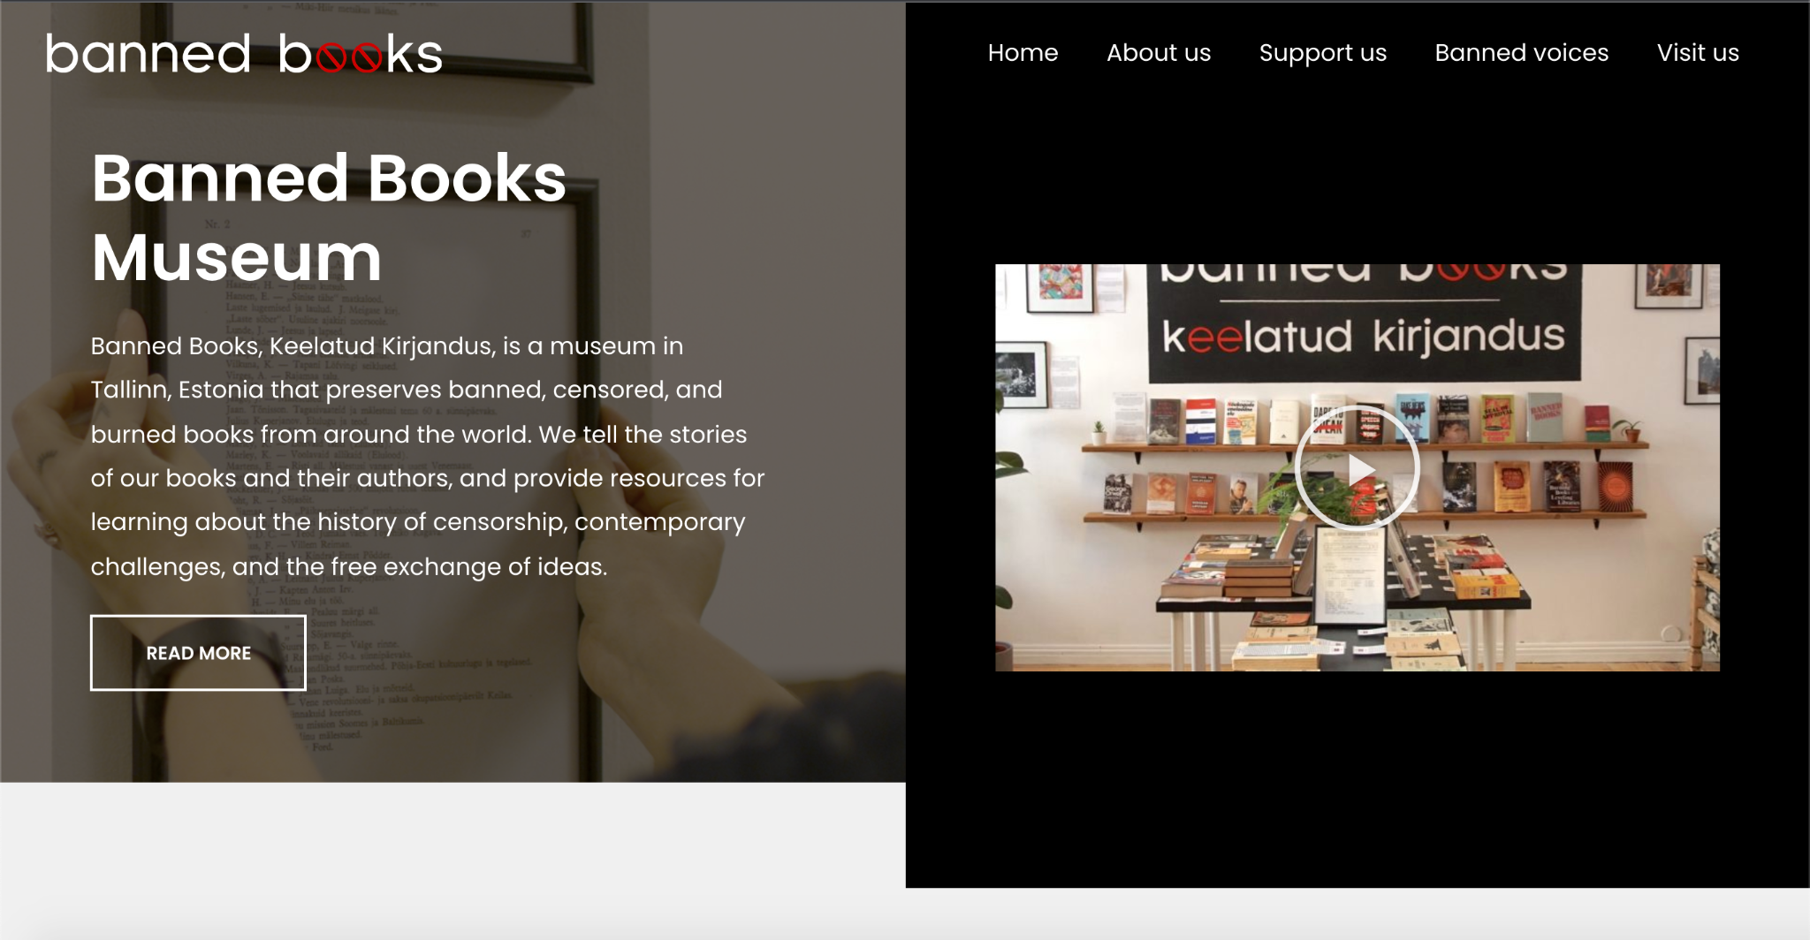
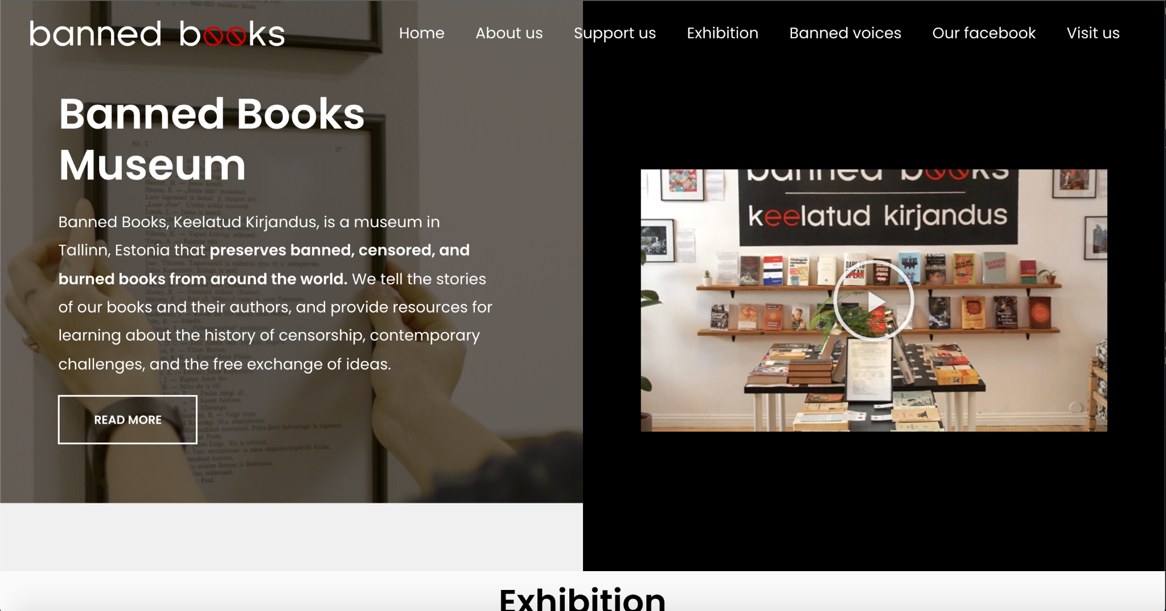
The comparison between the site and a Hi-Fi prototype
The normal site:
The improved site:

Slide 8
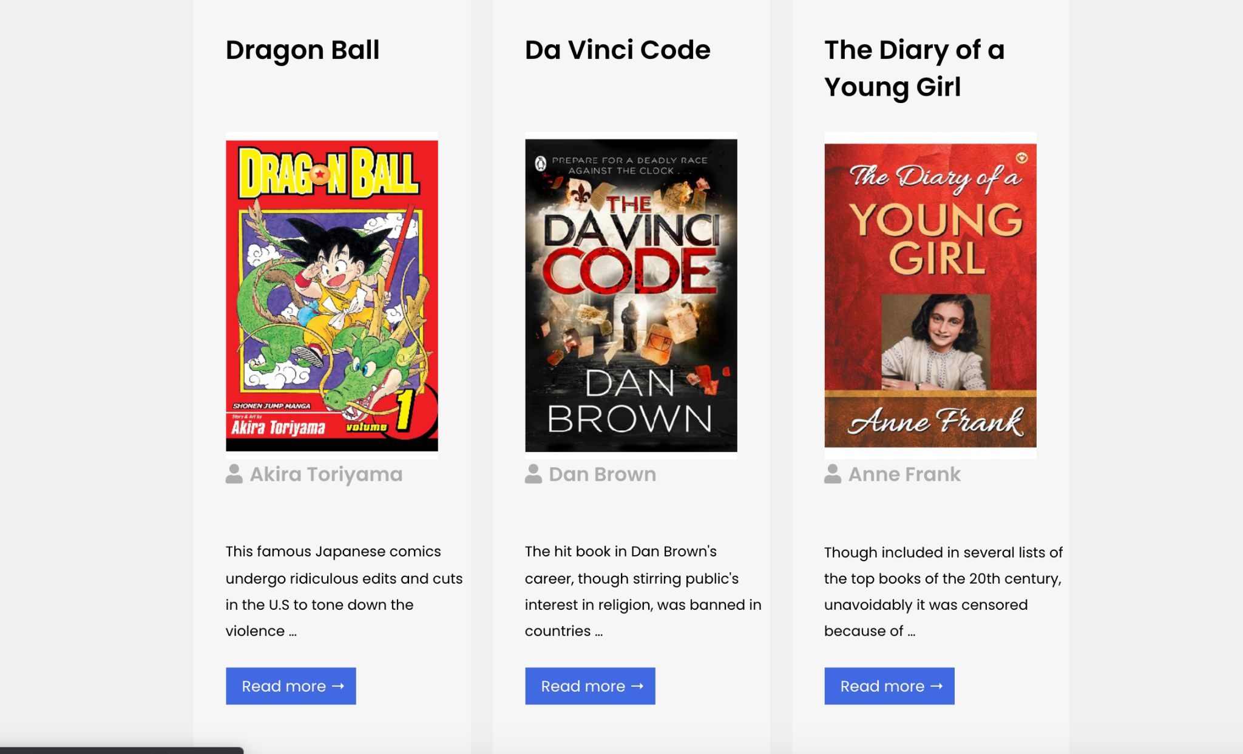
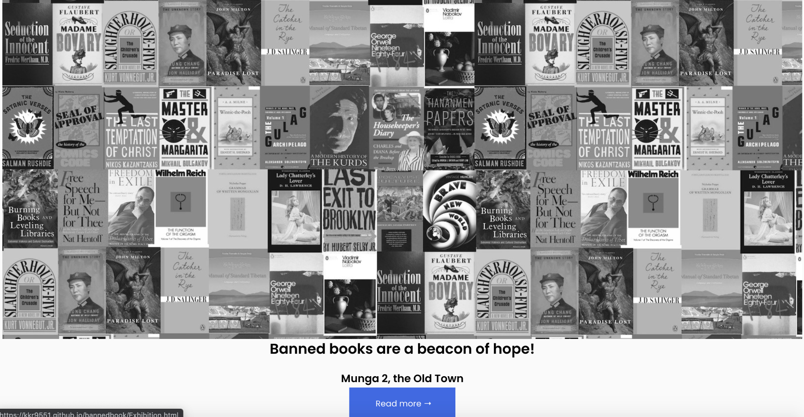
My work includes:
Correct the font size of important info (eg. the opening hours and address);
Add a new page exhibition to show info of famous books on exhibition;
Add the exhibition image and the link to the new page to the home page;
Make good use of an existing carousel of banned voices, create a carousel to display books on exhibition;
Add sub-pages for each book on the carousel to show basic information about the books;
Add a search bar to inform users that they could use it to search for more books;

Slide 9
Usability Testing
Facial Expression Analysis
1. Browse the website;
2. Find address (Most students detoured to find that));
3. Find the detailed info or anything helps you understand what this museum is doing;
4. How can you support them;
Attrakdiff questionnaire
Find the address (only one student detoured);
Look for some contents about books on exhibition and browse them for awhile;
Find the approach to donate books;
Find the access to Banned Books Museum’s Facebook (They tended to copy the link, but still successfully found the direct access);

Slide 10
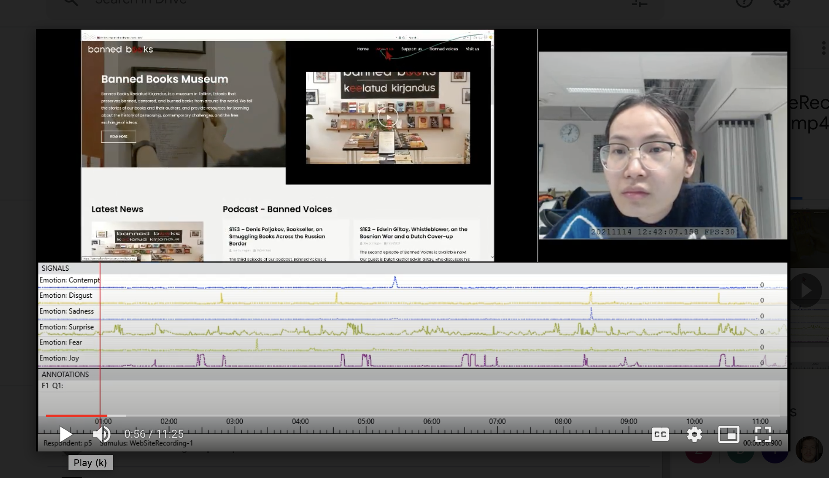
Facial Expression Analysis Results
The most emotion participants expressed was Surprise;
The emotion Joy, disgust and Surprise coincided;
Participants had trouble in finding the address, leading to negative emotions;
The negative emotions last shortly; then, participants felt surprised and joyful quickly since it was not so hard to figure out a way to complete the task;
(The screenshot is consented by Na Zhu)

Slide 11
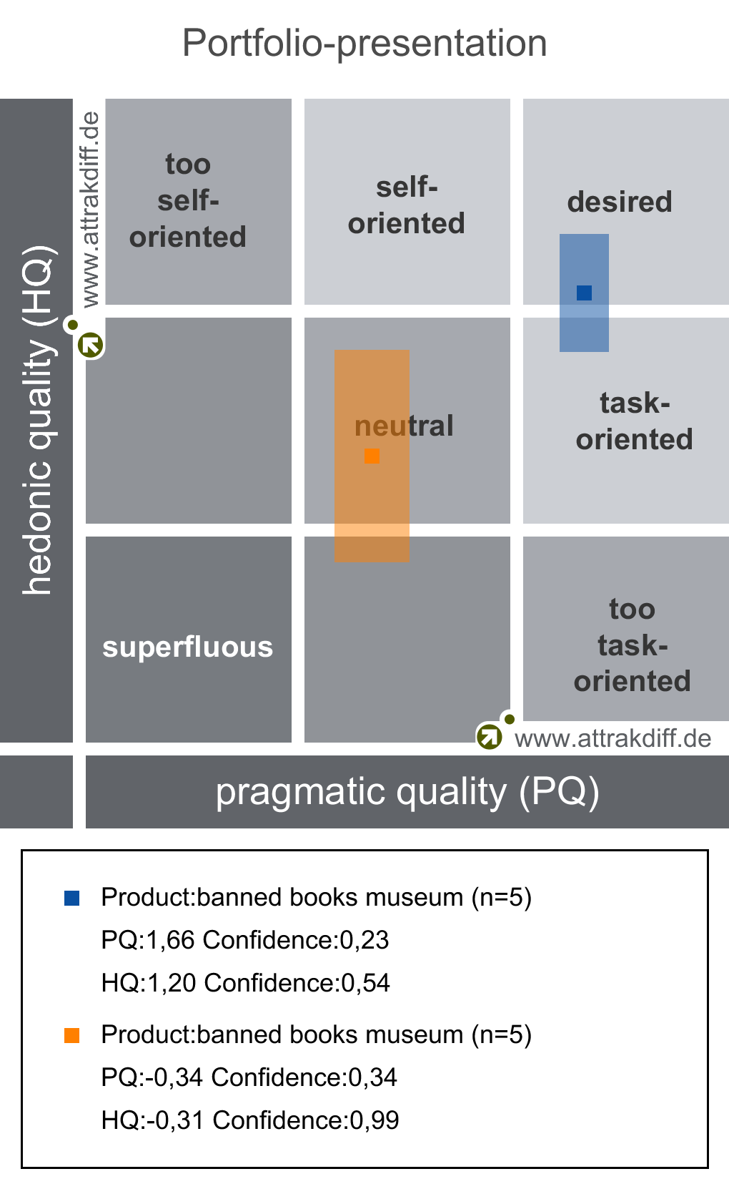
Attrakdiff Results
The improved one was rated as desired and task-oriented;
Most participants held reserved attitudes towards the PQ for the normal site;
The confidence interval of HQ for the normal site is much wider, showing that self-reported HQ varied widely;

Slide 12
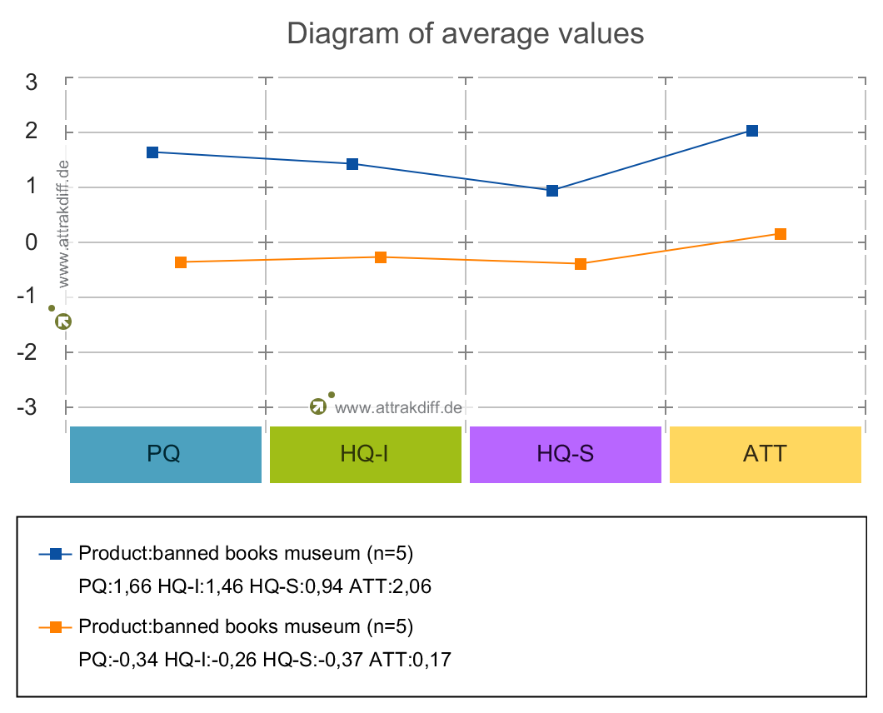
Attradiff Results
The average values of Pragmatic Quality, Hedonic Quality - Simulation, Hedonic Quality - Identity, and Attractiveness are above the average line;
The average values of Hedonic Quality - Identity are below the average line;

Slide 13
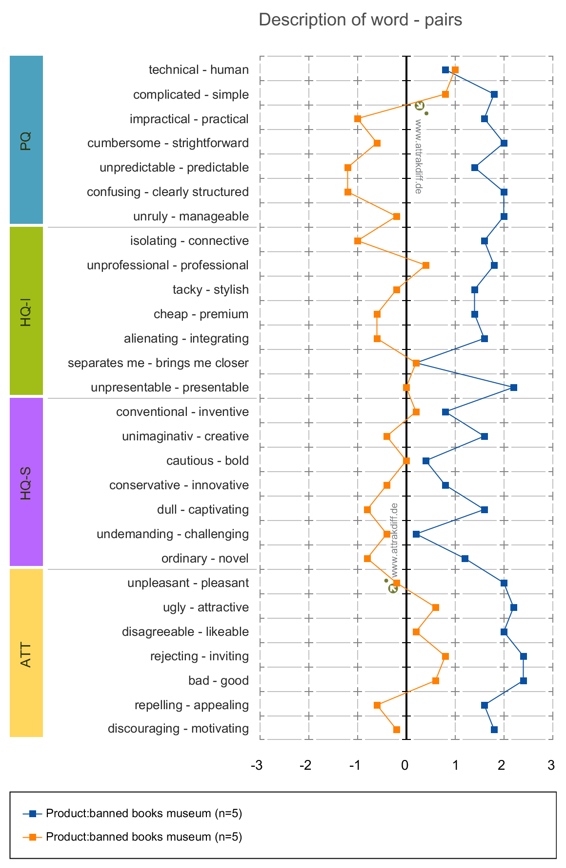
Attrakdiff Results
Significant differences appear in all four dimensions (PQ, HQ-I, HQ-S, ATT);
By contrast, the improved site successfully offered users
direct navigation; all information on the site is clearly structured;
higher accessibility; the distance between users and the site were narrowed;
It can evoke user’s joyfulness because the design is appealing, novel and creative,

